Slide 1
Data Transmission Modes

Slide 2
Data Transmission Modes
Data transmission refers to the movement of data in form of bits between two or more digital devices.

Slide 3
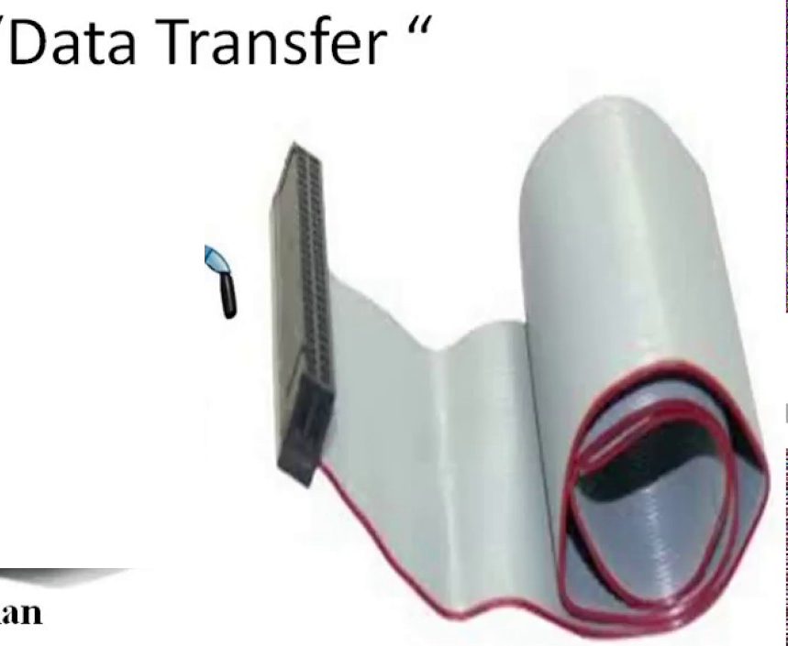
Data Bus
A data bus is a computer subsystem that allows for the transferring of data from one component to another on a motherboard or system board, or between two computers.
This can include transferring data to and from the memory, or from the central processing unit (CPU) to other components.

Slide 4
Transmission Modes
Transmission modes can be divided into two fundamental categories:
Serial — one bit is sent at a time
Parallel — multiple bits are sent at the same time

Slide 5
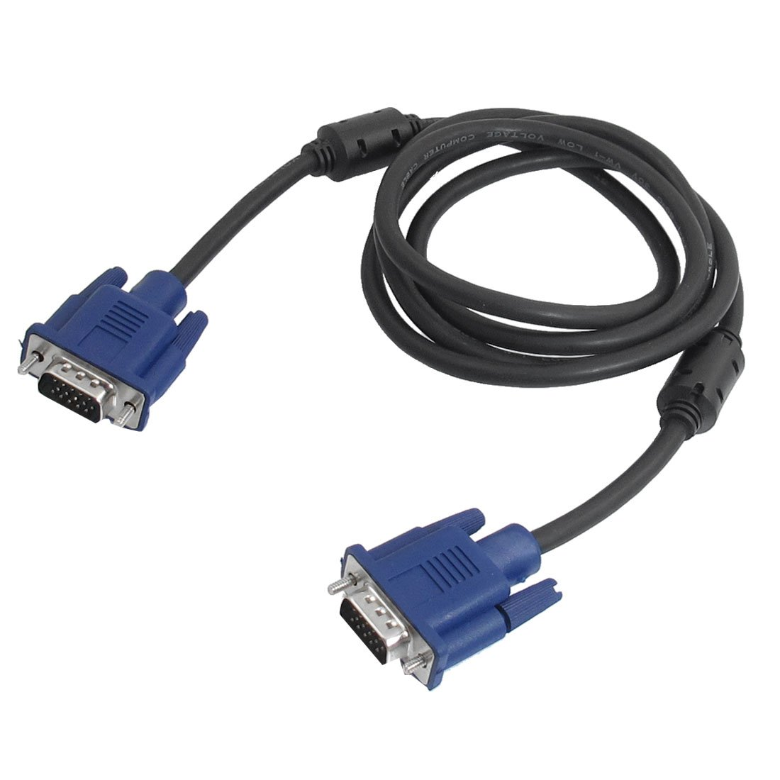
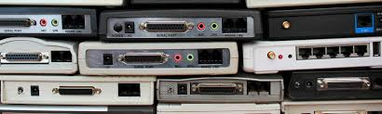
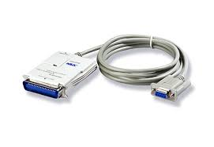
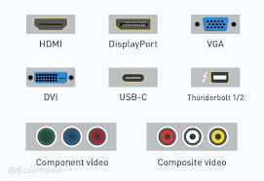
Convertor
VGA 15 Pin Male to Male Plug Computer Monitor Cable Wire Cord 1.5M
A conversion process in which the stream of data elements received all at once is converted and sent as a stream of data at one bit at a time.

Slide 6
Parallel transmission
all the bits of data are transmitted simultaneously on separate communication lines.
Send data n bits at a time instead of 1. This is called parallel transmission.
Use n wires to send n bits at one time.

Slide 7
Advantage & Disadvantage
Advantage :
It is speedy way of transmitting data as multiple bits are transmitted simultaneously with a single clock pulse.
Disadvantage:
It is costly method of data transmission as it requires n lines to transmit n bits at the same time.

Slide 8
Serial Transmission
Data is transmitted as a single bit at a time using a fixed time interval for each bit.
Serial transmission sends one bit at a time.

Slide 9
Advantage & Disadvantage
Advantage
Use of single communication line reduces the transmission line cost by the factor of n as compared to parallel transmission.
Disadvantages
1. Use of conversion devices at source and destination end may lead to increase in overall transmission cost.
2. This method is slower as compared to parallel transmission as bits are transmitted serially one after the other.

Slide 10
Serial transmission occurs in one of three ways:
asynchronous,
synchronous, and
isochronous.

Slide 11
Asynchronous Transmission
data is sent in form of byte or character.
This transmission is the half duplex type transmission.
In this transmission start bits and stop bits are added with data.
In asynchronous transmission, we send 1 start bit (0) at the beginning and 1 or more stop bits (1s) at the end of each byte. There may be a gap between bytes.

Slide 12
Advantages of Asynchronous Transmission
This is a highly flexible method of data transmission.
Synchronization between the receiver and transmitter is unnecessary.
It helps you to transdifferent bit ratesmit signals from the sources which have.
The Transmission can resume as soon as the data byte transmission is available.
This mode of Transmission is easy for implementation.

Slide 13
Disadvantages of ASynchronous Transmission
In Asynchronous Transmission, additional bits called start and stop bits are required to be used.
The timing error may take place as it is difficult to determine synchronicity.
It has a slower transmission rate.
May create false recognition of these bits because of noise on the channel.

Slide 14
Synchronous Transmission
send bits one after another without start or stop bits or gaps.
It is the responsibility of the receiver to group the bits.
the bit stream is combined into longer “frames,” which may contain multiple bytes.

Slide 15
Advantages of Synchronous Transmission
It helps you to transfer a large amount of data.
It offers real-time communication between connected devices.
Each byte is transmitted without a gap between the next byte.
It also reduces time timing errors.

Slide 16
Disadvantages of Synchronous Transmission
The accuracy of the received data depends on the receiver's ability to count the received bits accurately.
The transmitter and receiver need to operate simultaneously with the same clock frequency.

Slide 17
Isochronous
data transfer system combines the features of an asynchronous and synchronous data transfer system.
The isochronous transmission guarantees that the data arrive at a fixed rate.

